Slide 1

Internet of Things
Derek Badman
Pat Maynard
Linda George
Noor Pola

Slide 2
Introduction
The term IoT, or Internet of Things, refers to the collective network of connected devices and the technology that facilitates communication between devices and the cloud, as well as between the devices themselves.
It describes the network of physical objects—“things”—that are embedded with sensors, software, and other technologies for the purpose of connecting and exchanging data with other devices and systems over the internet.

Slide 3

Introduction
These devices range from ordinary household objects to sophisticated industrial tools.
With more than 7 billion connected IoT devices today, experts are expecting this number to grow to 22 billion by 2025.

Slide 4
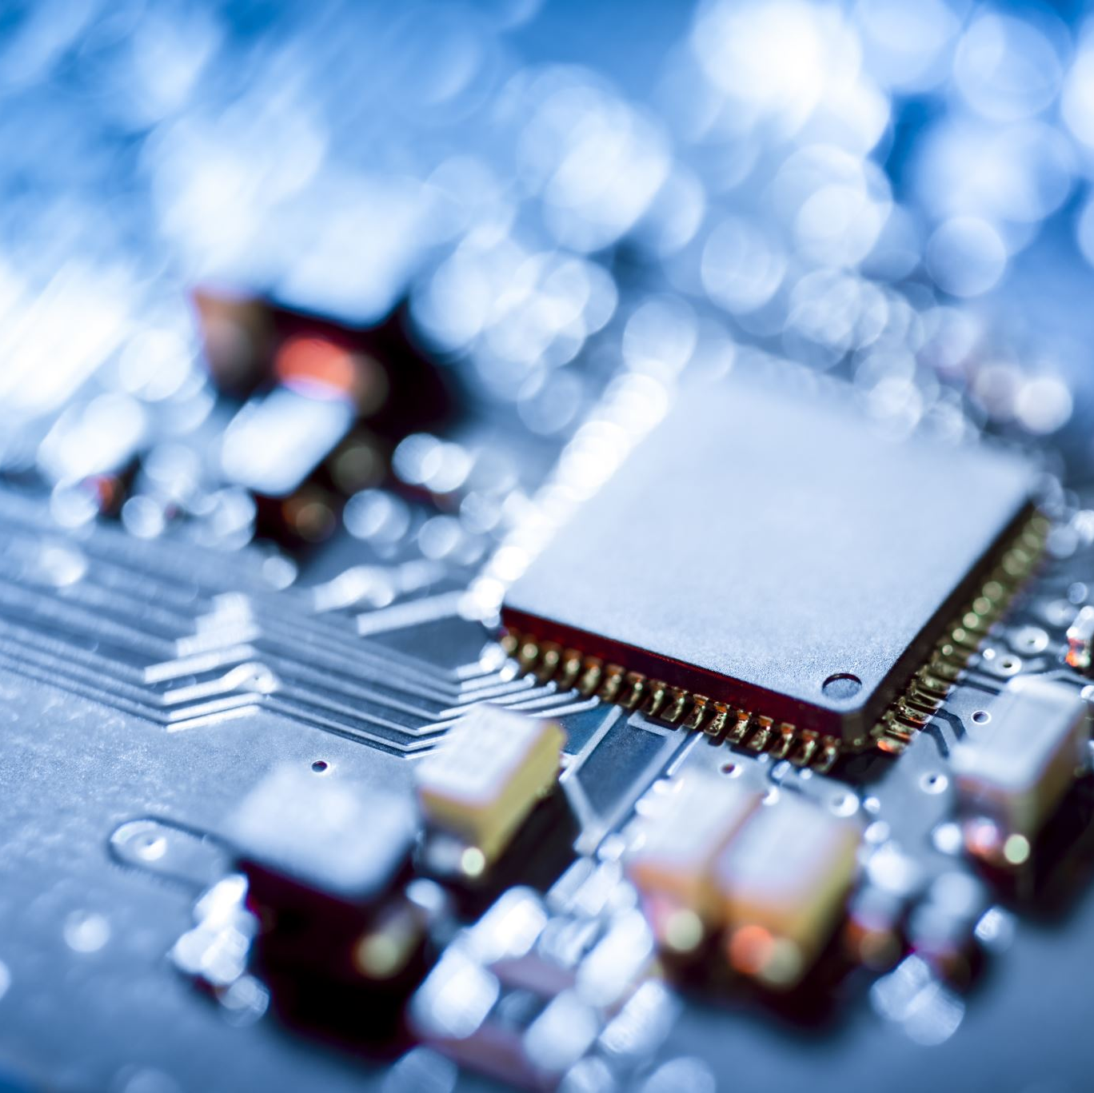
What is IoT?!
The Internet of Things integrates everyday “things” with the internet.
Computer Engineers have been adding sensors and processors to everyday objects since the 90s.
However, progress was initially slow because the chips were big and bulky.
Low power computer chips called RFID tags were first used to track expensive equipment.
As computing devices shrank in size, these chips also became smaller, faster, and smarter over time.

Slide 5
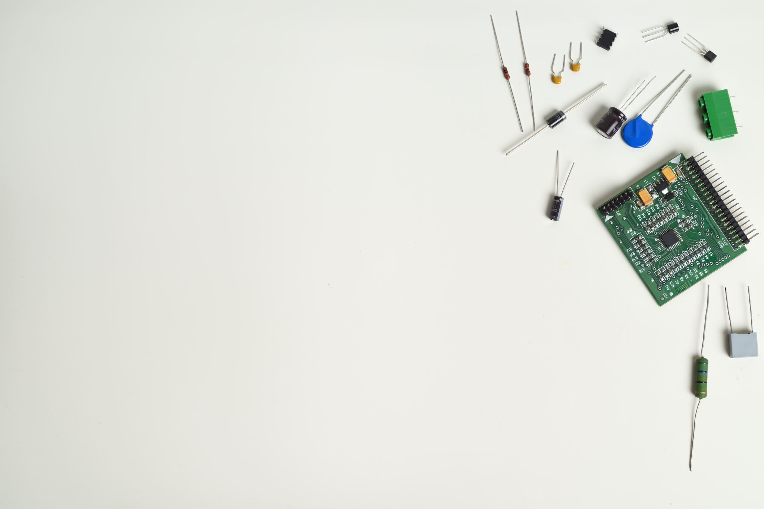
What is IoT?!
An IoT system has three components:
Smart devices
IoT application
A graphical user interface

Slide 6
What is IoT?!
Examples of IoT systems in use today:
Connected cars
Connected homes
Smart buildings
Smart cities

Slide 7
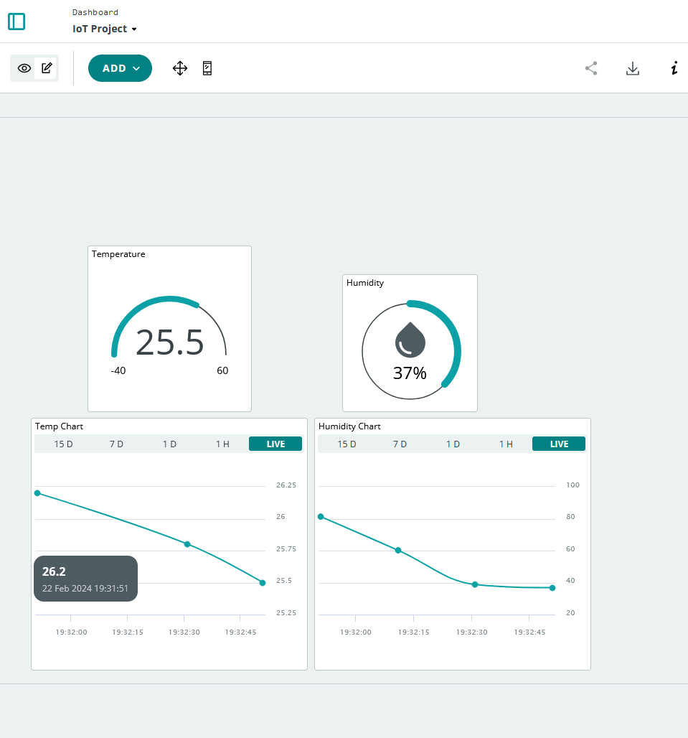
Our Experiment!
We set out to make a simple IoT cloud-based temperature and humidity monitoring system.

Slide 8
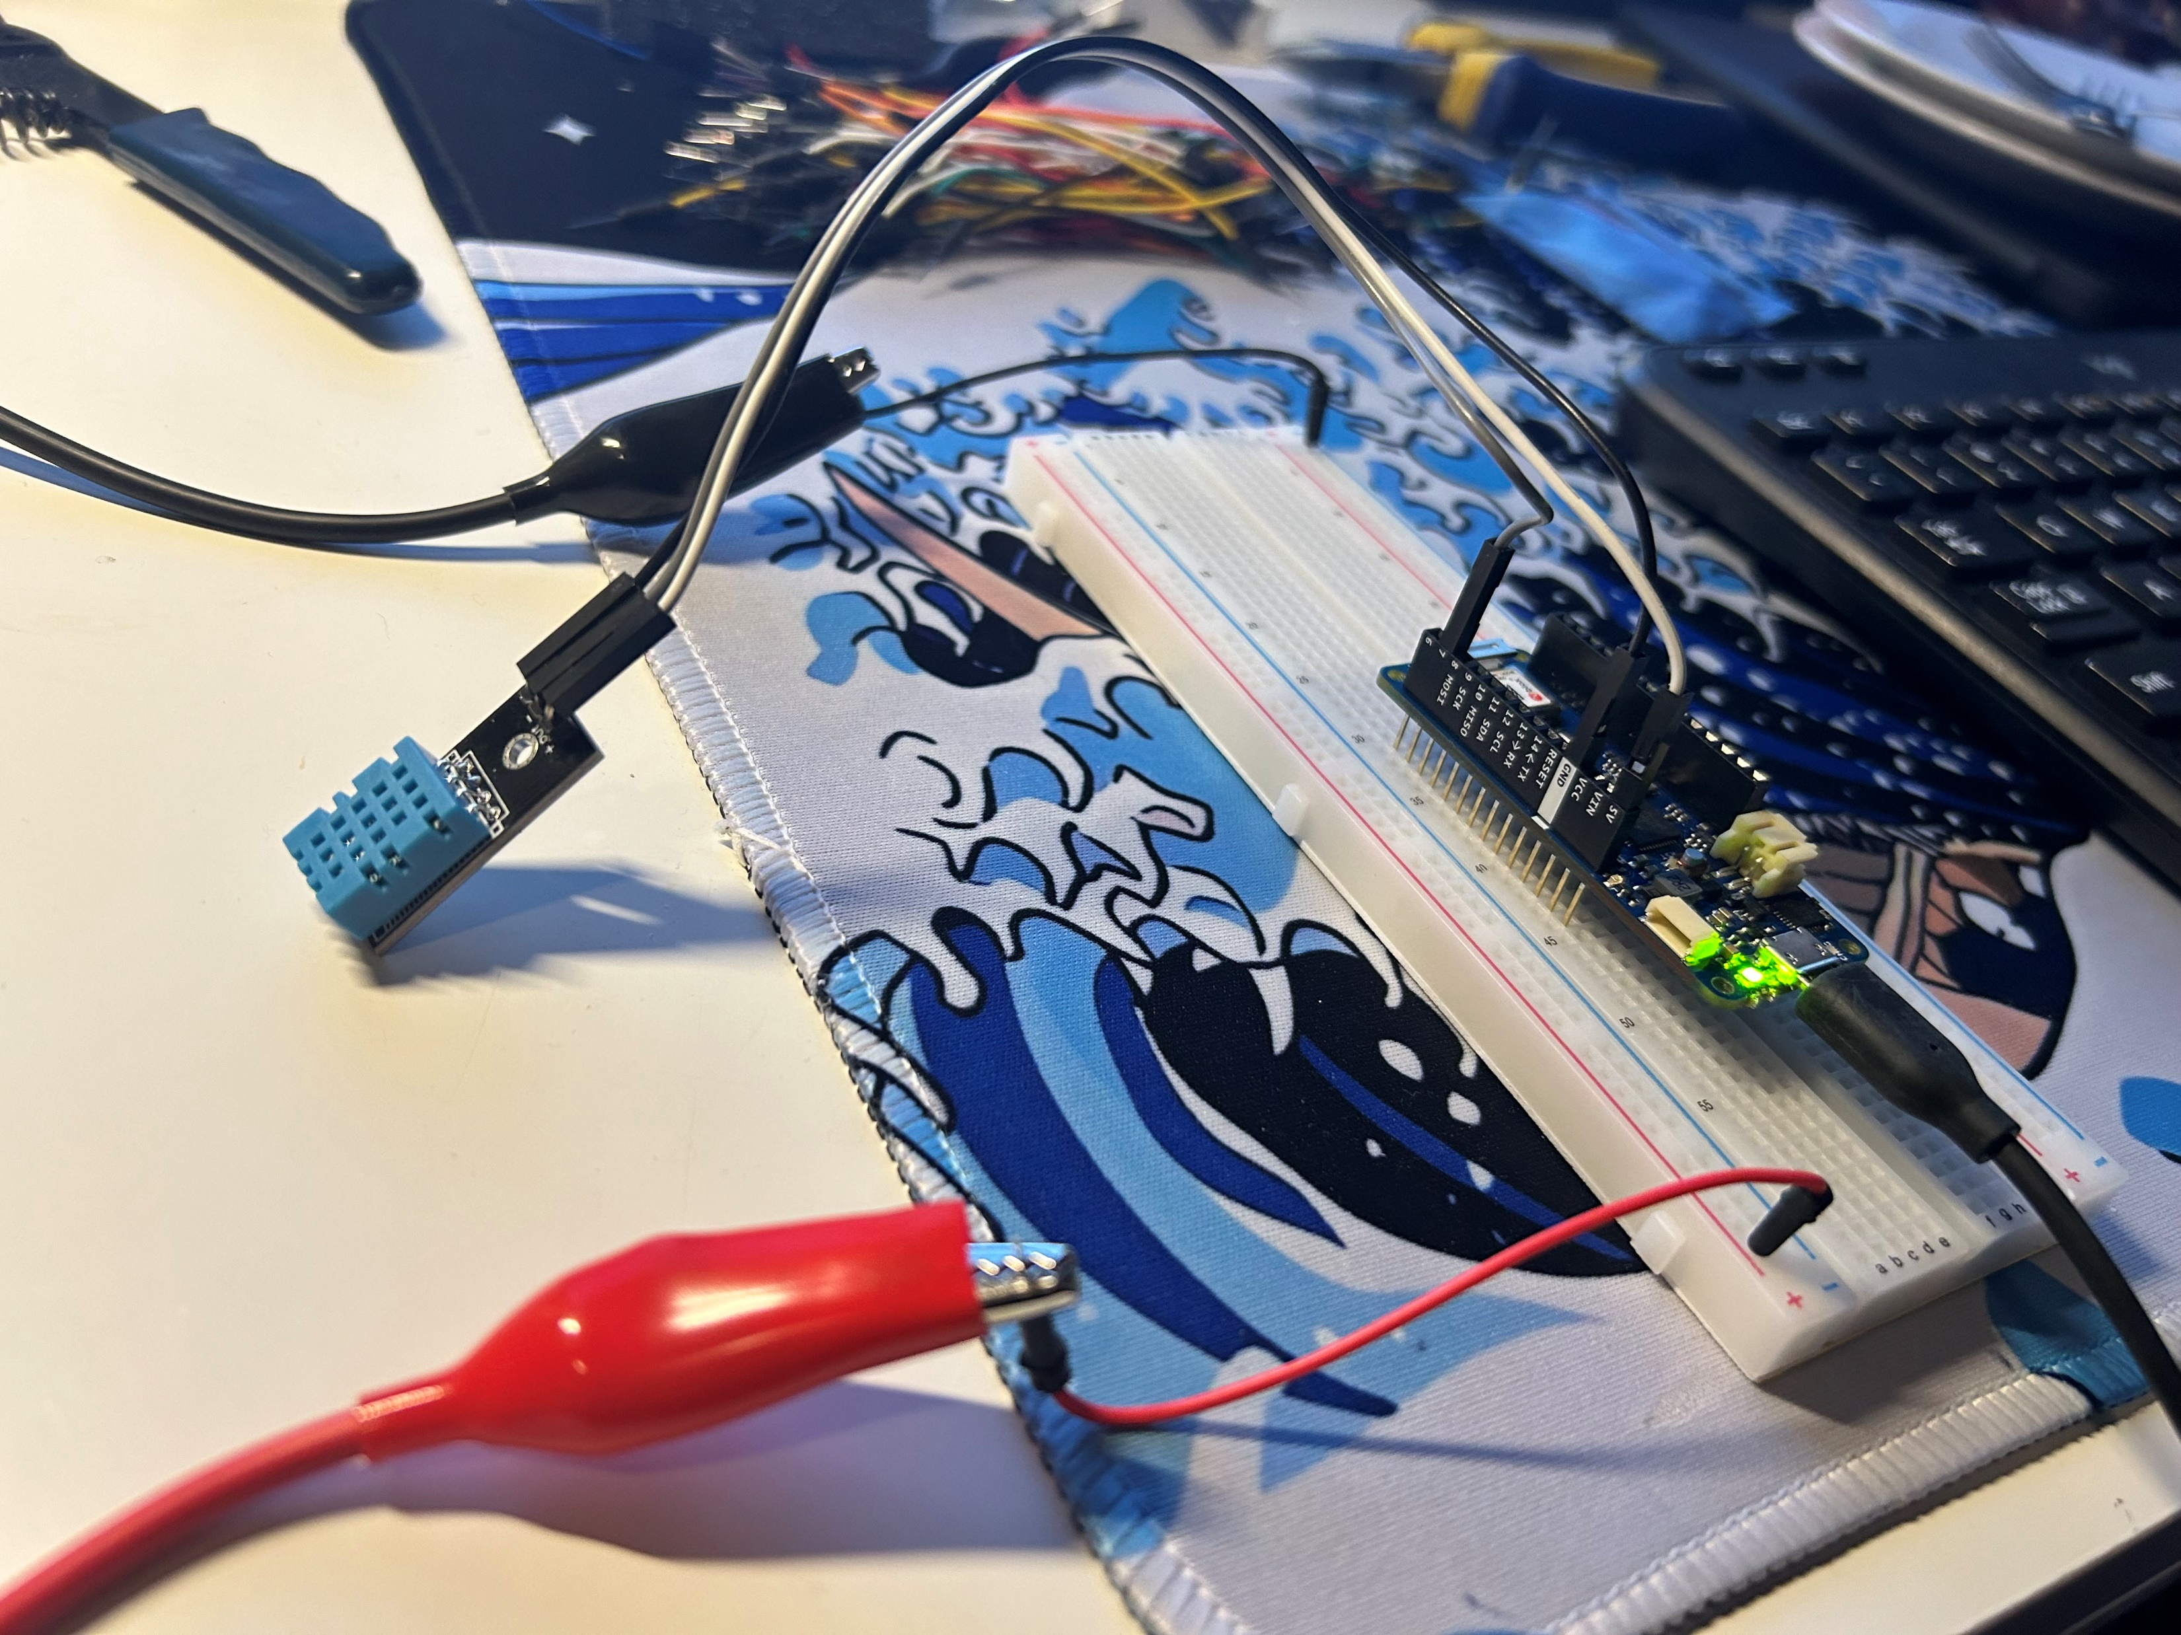
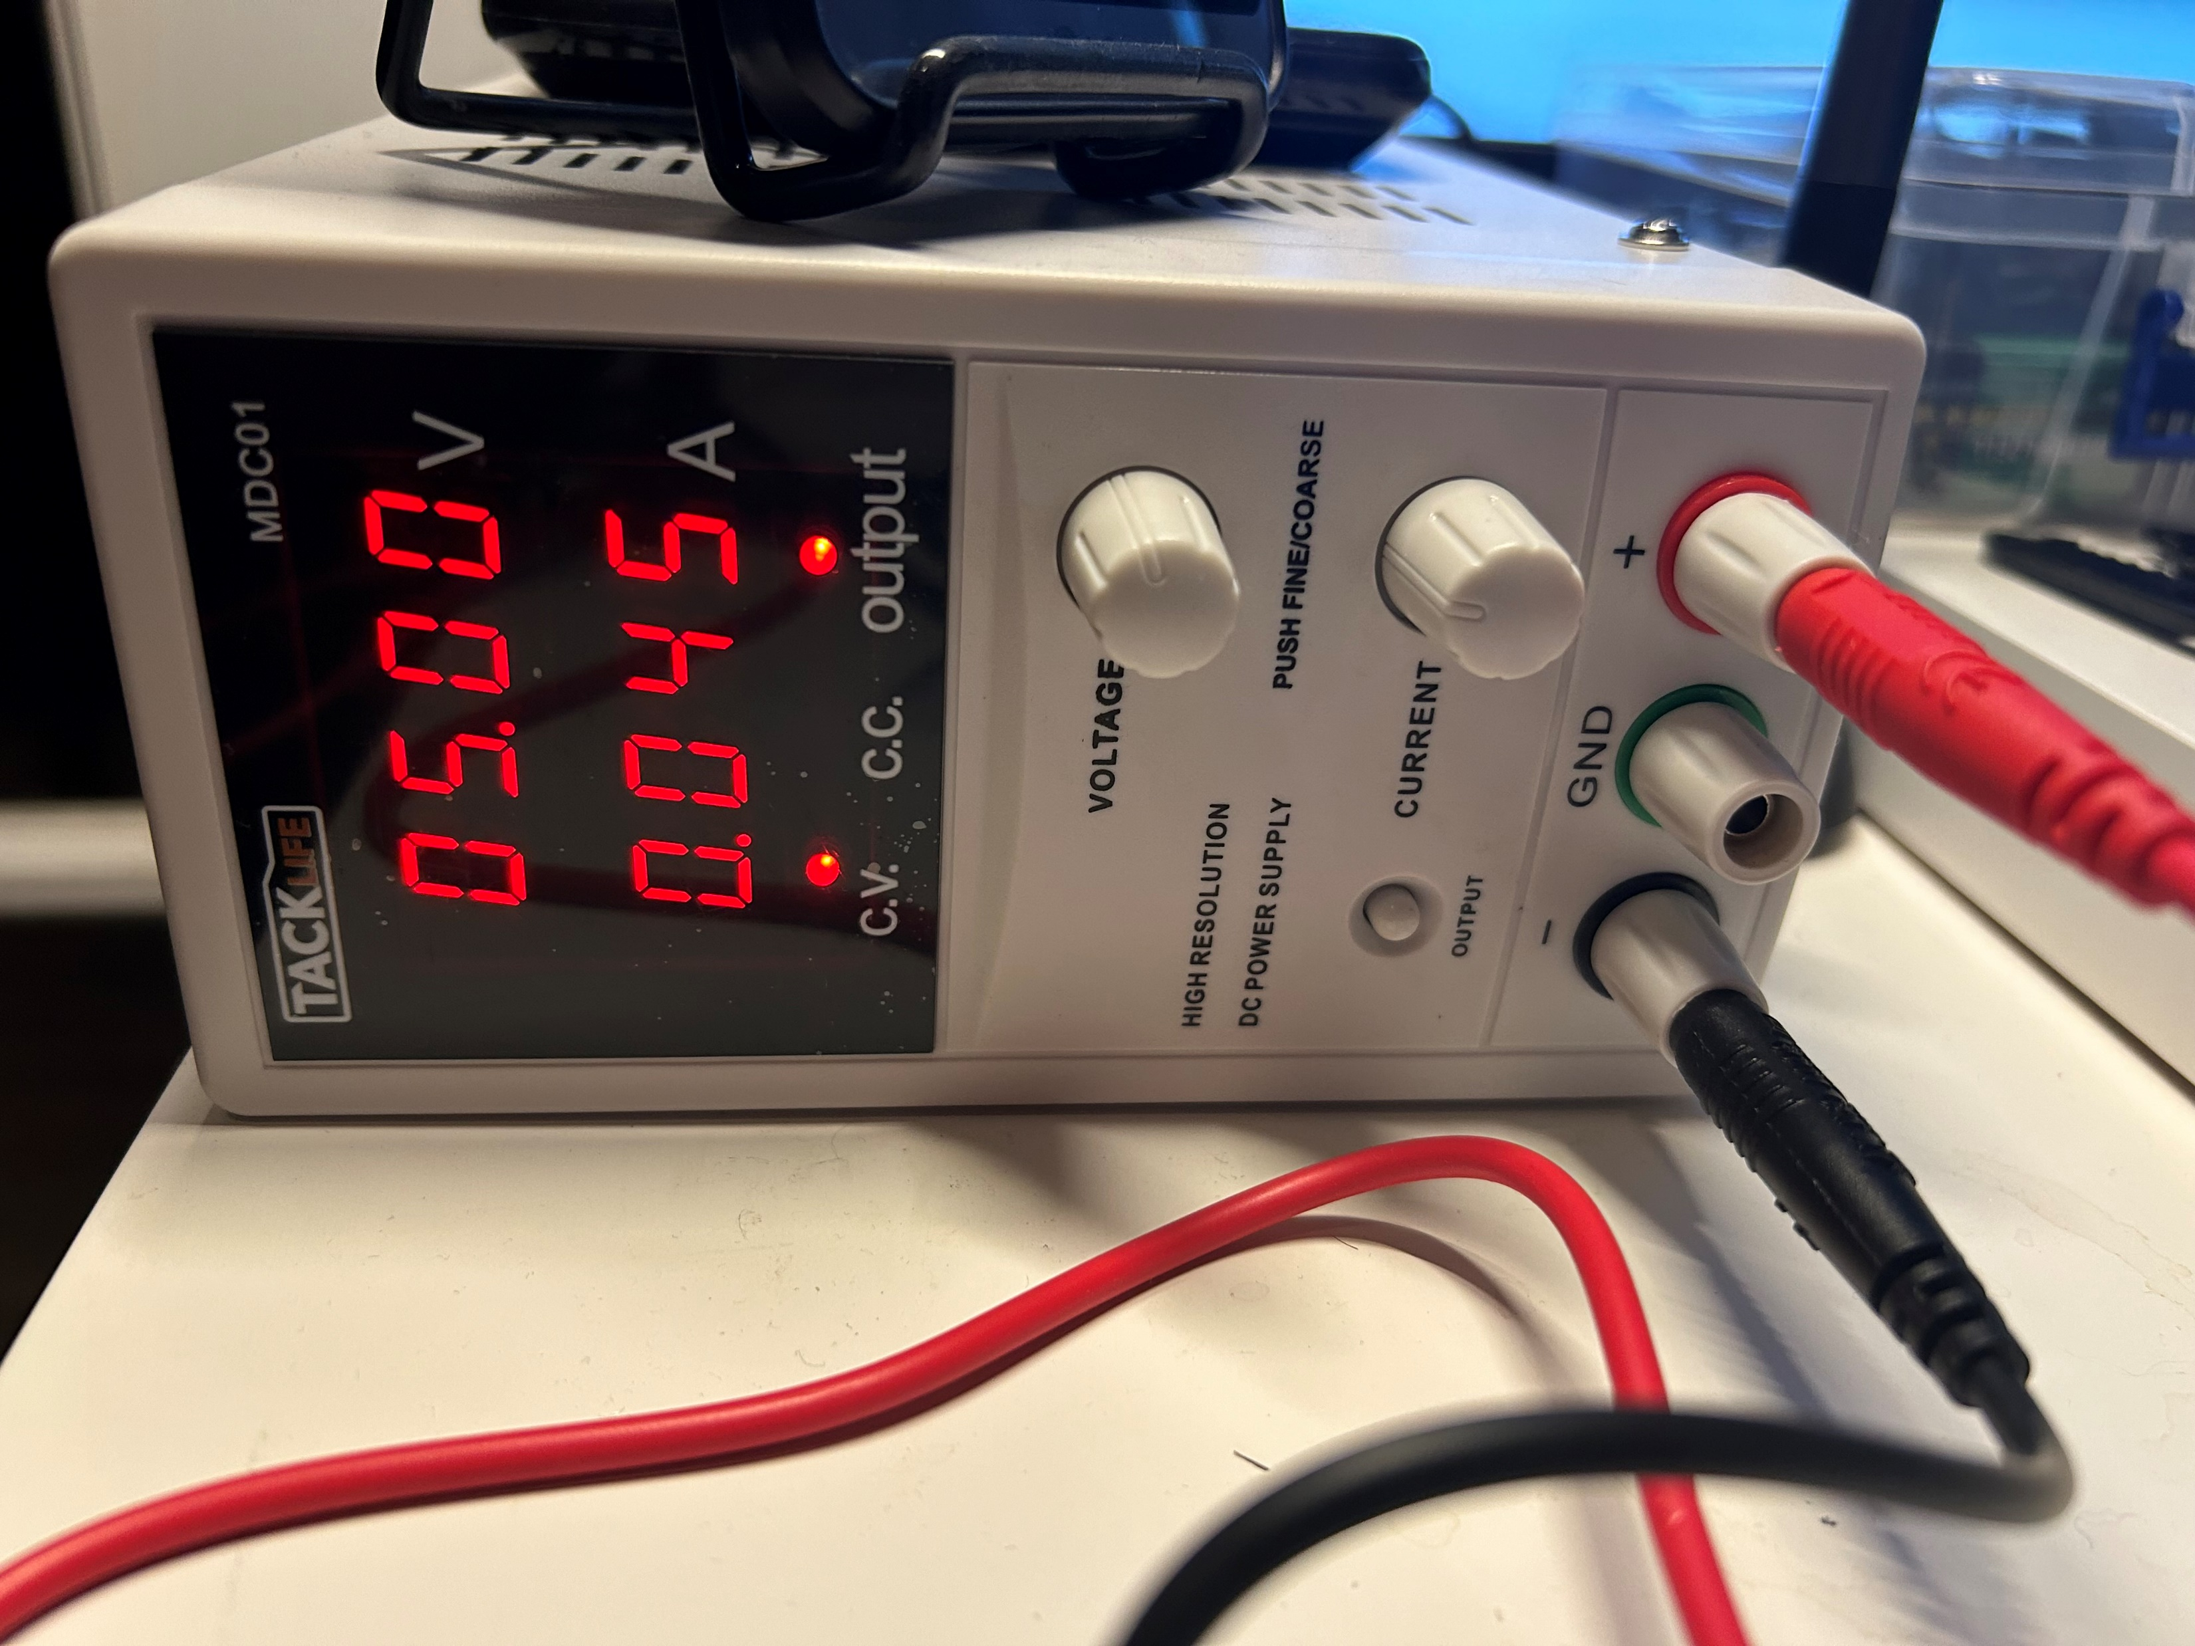
Physical Set-up
We connected an Arduino MKR 1010 wi-fi-enabled board to a DHT multi-function sensor and a power supply to send the signal to our cloud.

Slide 9
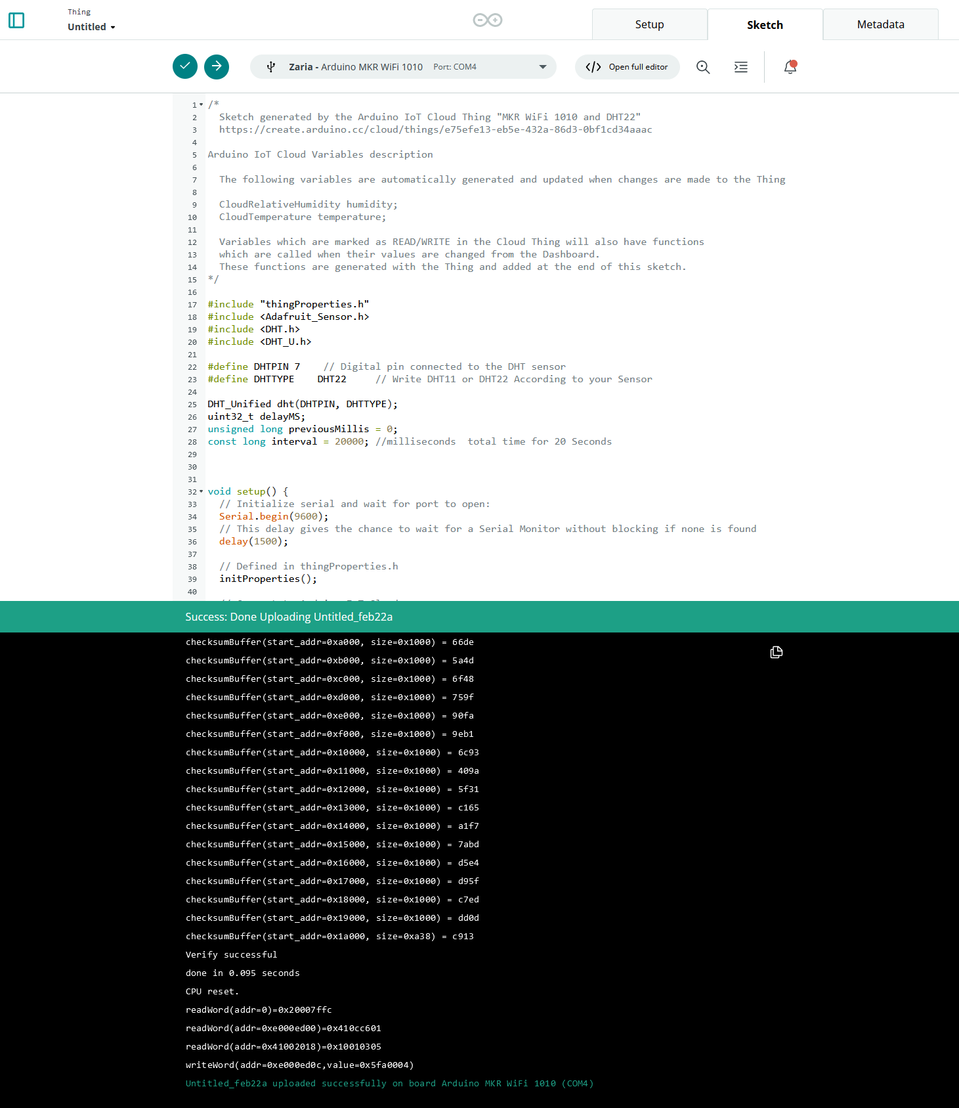
Code
Adding boilerplate code to the board for base functionality was the next step.
We used the browser-based IDE provided by Arduino Cloud.

Slide 10
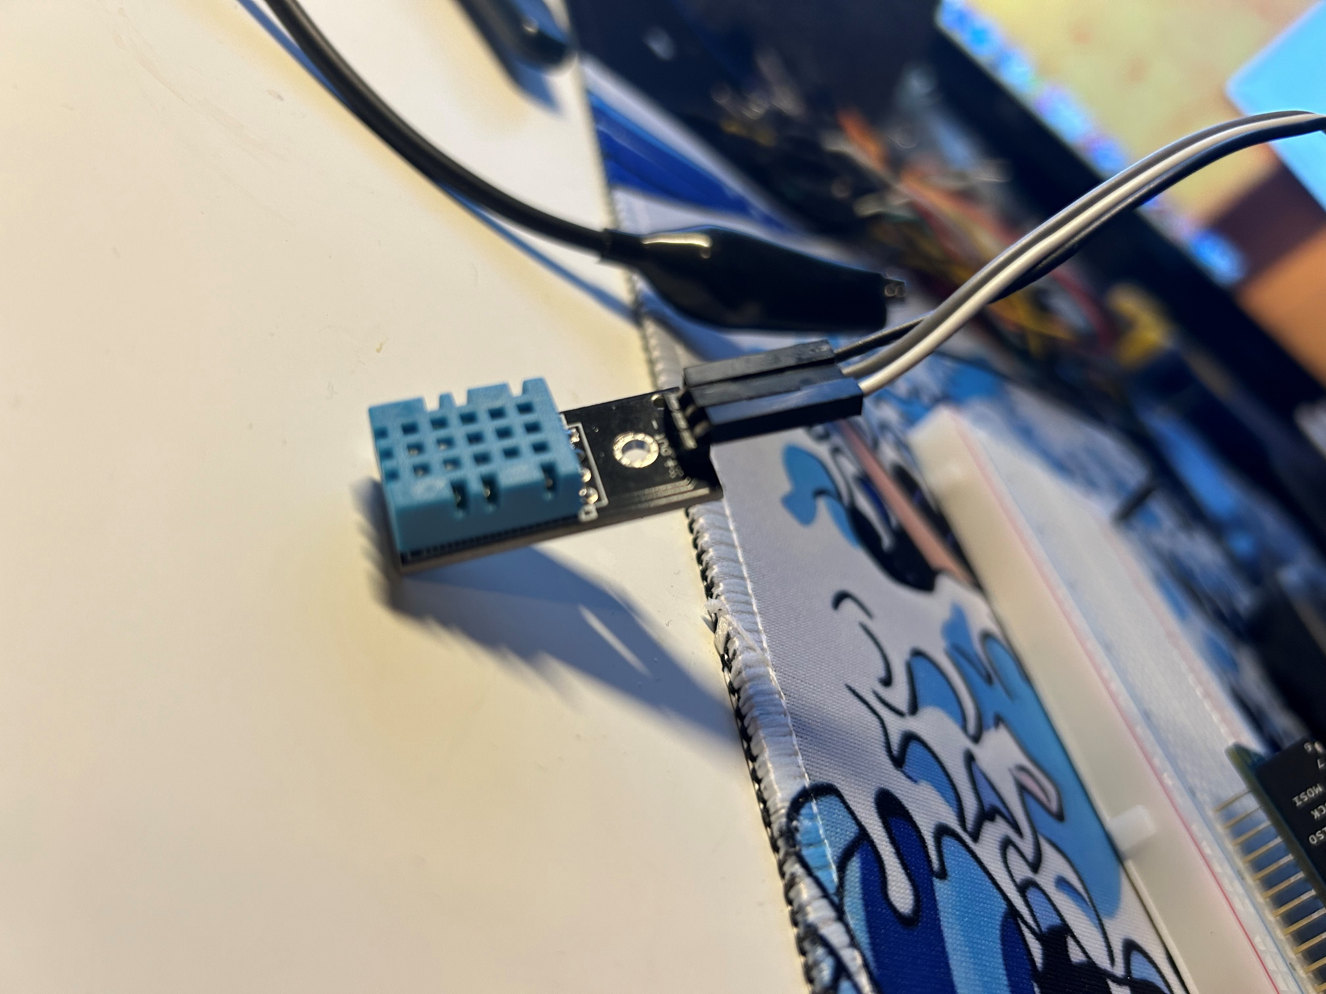
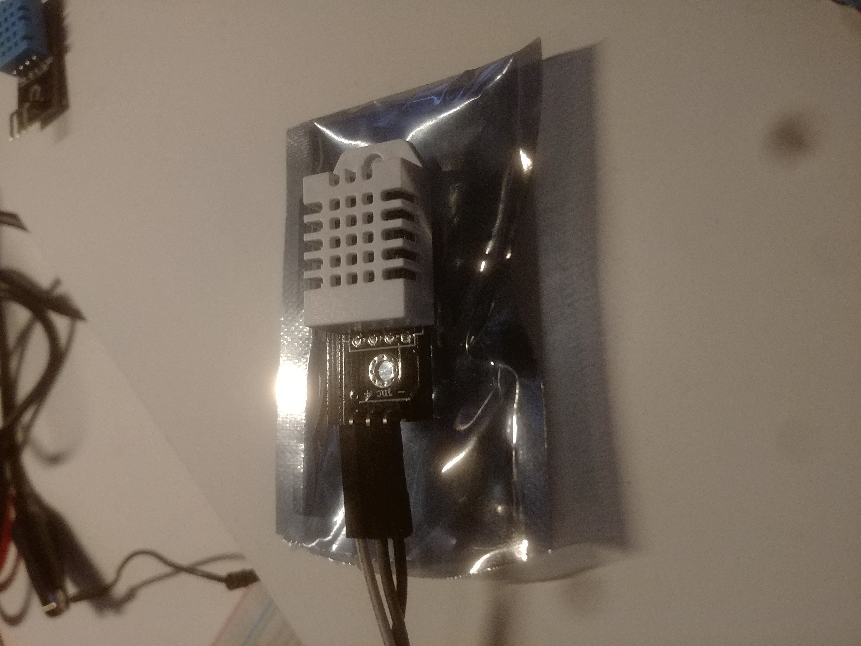
Troubleshooting
We had VERY high outputs initially. This raised a red flag that something was wrong with our setup.
After some analysis, replacing our sensor was necessary.
Switched from a DHT11 (Blue) to a DHT22 (White)

Slide 11
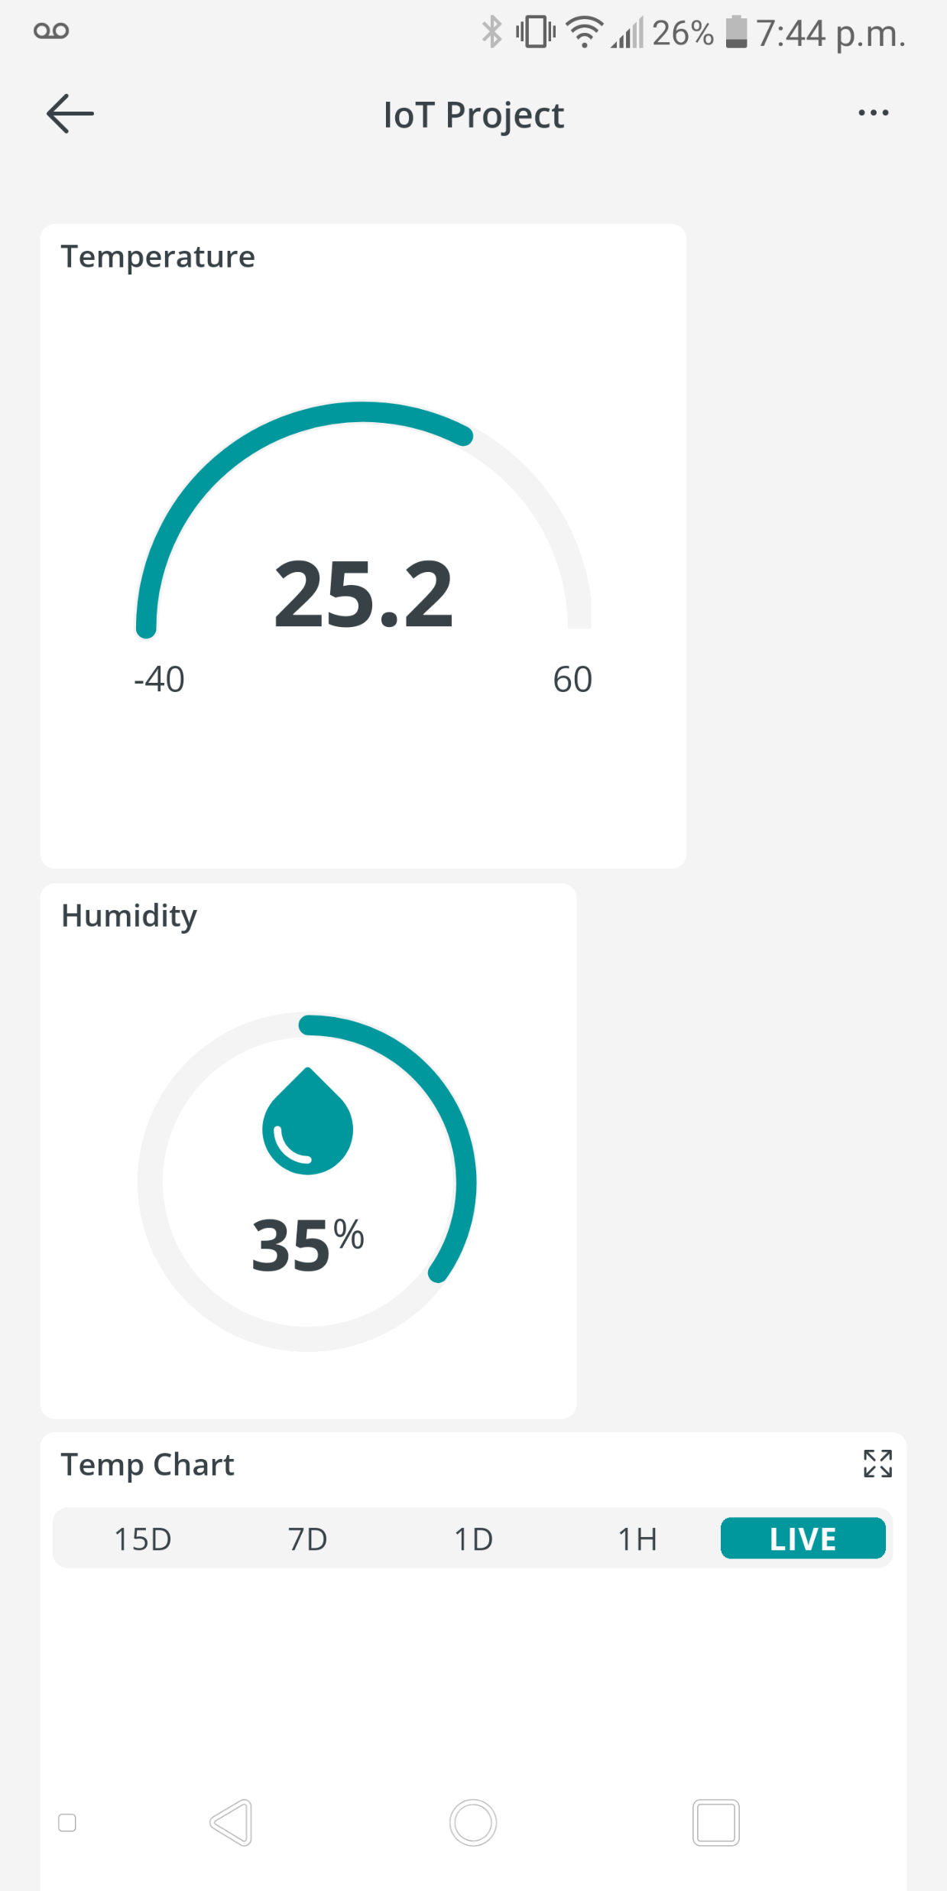
Dashboard
The final dashboard was a multi-platform output of our IoT sensor running on the cloud!

Slide 12
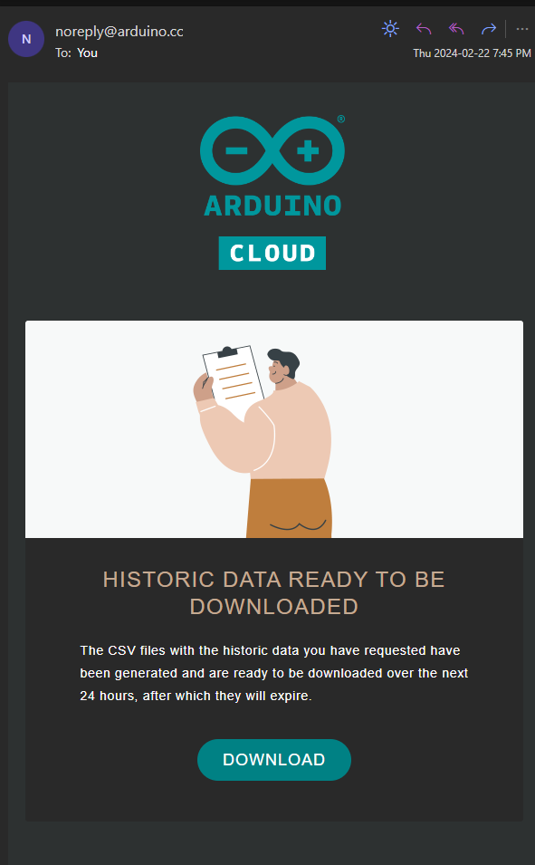
Data Export
After a few days of collecting data, we were able to export a CSV from the cloud to see what we have been gathering.

Slide 13
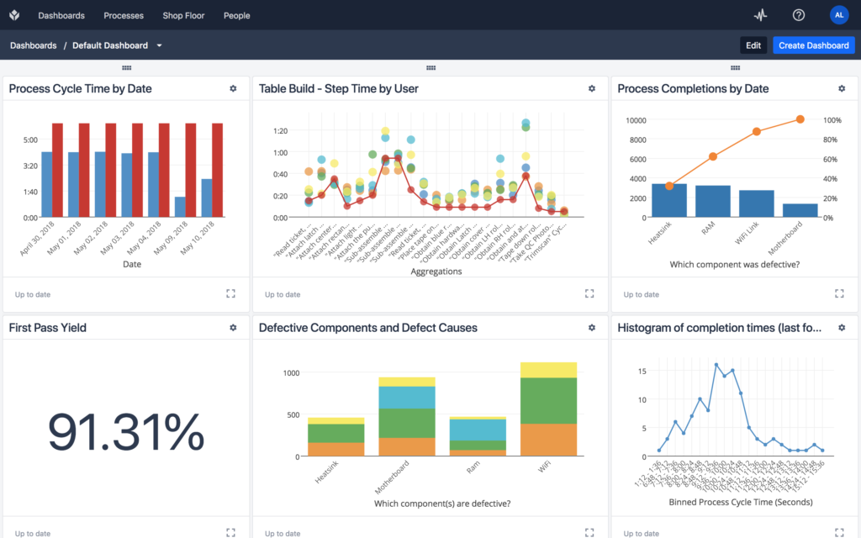
IoT in Industry
Smart Manufacturing to display real-time production data through IIoT monitoring:
Cycle Times
Operator Efficiency
Defects/Rejects
Production Count
Alerts
Rate of Climb

Slide 14
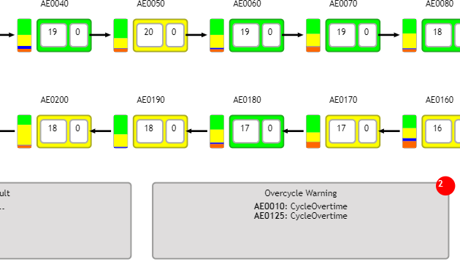
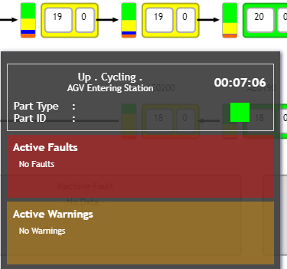
IoT in Industry
IIoT Monitoring Dashboard to improve production output, machine maintenance and product quality:
Plant Layout
Faults/Warnings
Machine Status
Asset Tracking

Slide 15
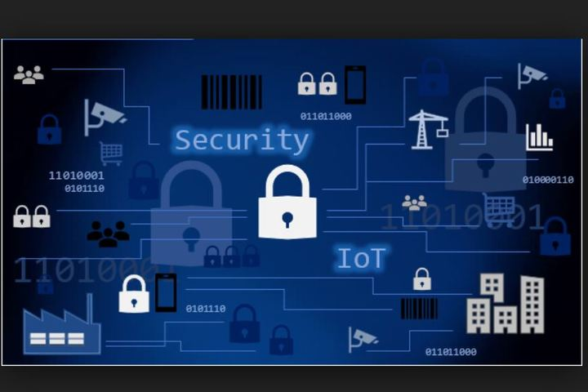
Security and Implementation
Security Methods:
Access Control
Device Authentication
Network Segmentation
Data Encryption
Network Monitoring

Slide 16
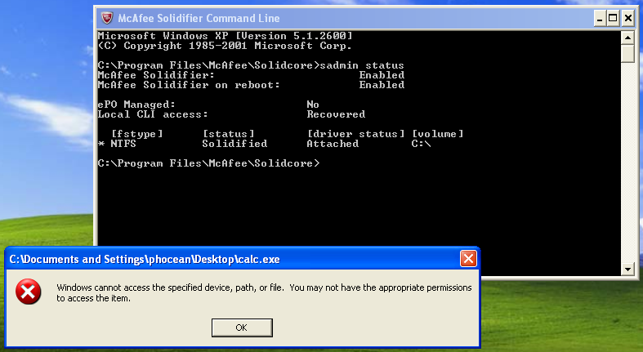
Security and Implementation
McAfee’s Solidcore software:
Eliminates risks of network being compromised
Reduces risk of malware infections
Prevents unauthorized software execution
Prevents unauthorized changes to existing files and configurations
Secures endpoints from cyber attacks

Slide 17

Next Steps for IoT
IoT is expected to undergo rapid growth to support increased user interface. To succeed in developing a technology that will continue to make societal impacts and leave a lasting footprint in technological history. IoT will need to focus on the following areas of development:

Slide 18

Next Steps for IoT Security & Regulations
As internet crime increasingly continues to rise (125% in 2021 compared to 2020), cybersecurity and the regulations are an important focus.
IoT developers are expected to incorporate cybersecurity measures such as encryption, certificate-based authentication, and security standardization across platforms.
Developers will be challenged by ensuring the technology and security measures conform to privacy legislation across global jurisdictions.

Slide 19

Next Steps for IoT Trends in Technology
As society evolves, technology is expected to become ever more integrated into the consumer’s daily life.
Internet of Things is expected to expand to a futuristic society that incorporates technology such as smart cities, wearables, and transportation.
Developers are expected to focus much of their attention on ensuring the Internet of Things technology is advanced in a way that can support such a change in global societies.

Slide 20

Next Steps for IoT Market Growth
It is important for developers to be aware of the differing market needs and industries of the many users of the technology.
Developers will have to implement practical approaches and apply revolutionary techniques to ensure that different industries are accommodated.
There is no doubt that the Internet of Things will have a significant impact on society as a whole.

Slide 21
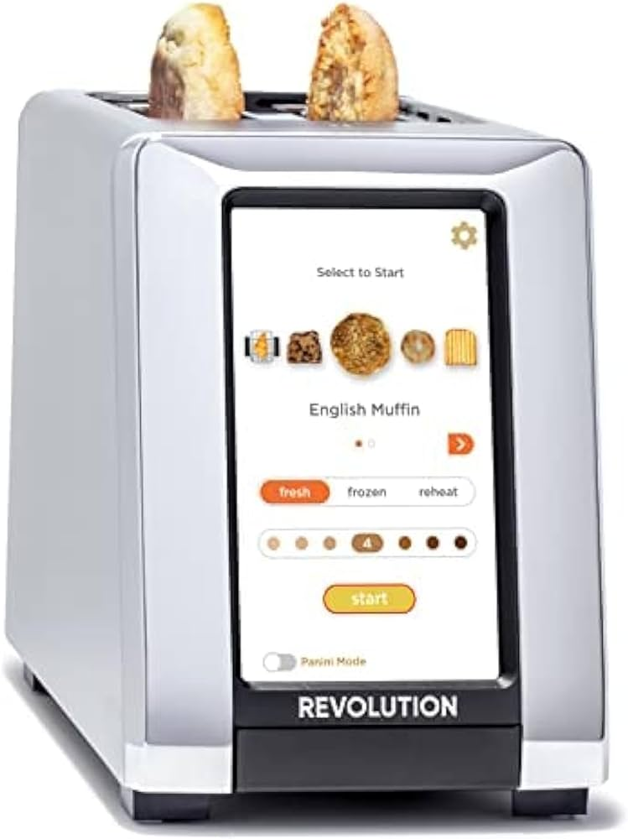
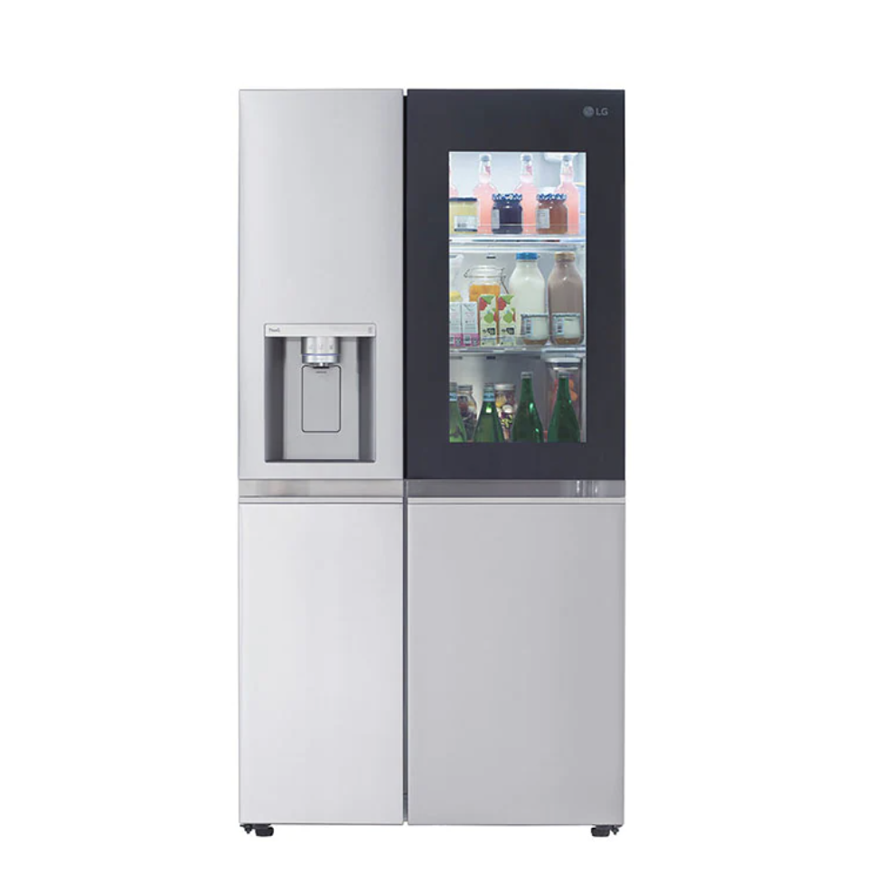
Summary
The Internet of Things is a rapidly growing platform that touches everything from everyday household items to industrial robots.
With emerging user-friendly technologies IoT is becoming accessible to everyone.
Cyber security must evolve with the technology to keep everyone’s information private.

Slide 22
References
LaFlamme, R., & LaFlamme, R. (2023, October 30). What’s next for the Internet of Things Auvik. https://www.auvik.com/franklyit/blog/future-of-it/
Temperature Monitoring with Arduino IoT Cloud using DHT22. (n.d.). projecthub.arduino.cc. https://projecthub.arduino.cc/attari/temperature-monitoring-with-arduino-iot-cloud-using-dht22-cd8e34
Imber, D. (2024, February 21). The Latest Cyber Crime Statistics (updated February 2024) AAG IT Support. AAG IT Services. https://aag-it.com/the-latest-cyber-crime-statistics#:~:text=Cyber%20Crime%20Overview,businesses%20and%20individuals%20in%2 2022.

Slide 23
Questions?

